Slide 1
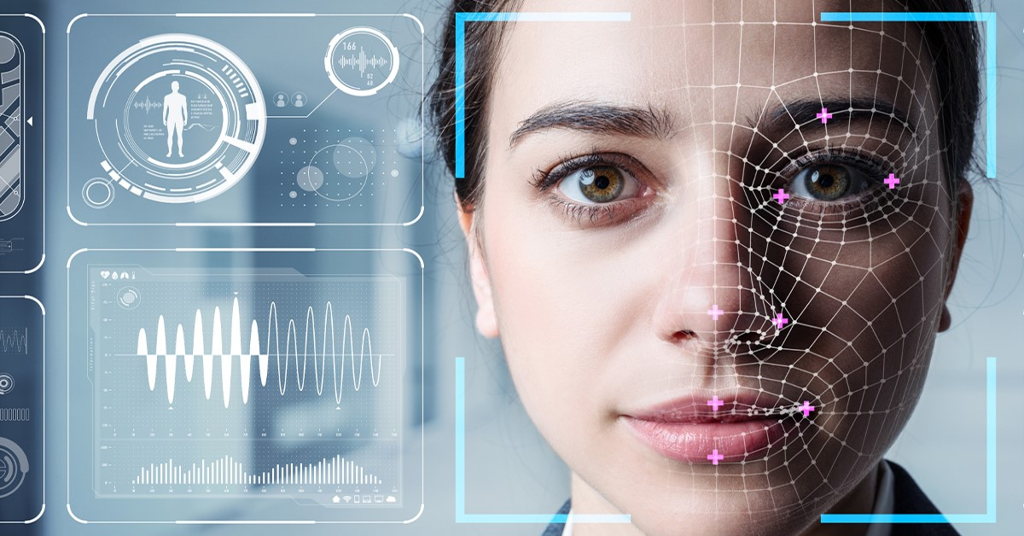
Emotion recognition

Slide 2
Team Member
Mariam Mounir Salama
Mohamed Alaa El-shamy
Mohamed El-bakray

Slide 3
Project Proposal :-
Emotion recognition : is the process of identifying human emotion. People vary widely in their accuracy at recognizing the emotions of others. Use of technology to help people with emotion recognition is a relatively nascent research area. Generally, the technology works best if it uses multiple modalities in context. To date, the most work has been conducted on automating the recognition of facial from video, spoken expressions from audio, written expressions from text, and physiology as measured by wearables.

Slide 4
In our project we will use picture to recognise and interpret human emotions
Via detect the location of face in any input image or frame. The output is the bounding box coordinates of the detected faces, Then Compare multiple faces together to identify which faces belong to the same person. This is done by comparing face embedding vectors, and finally Classifying the emotion on the face as happy, angry, sad, neutral, surprise, disgust or fear.

Slide 5
PEAS:-
Performance: 1-Speed
2-Accuracy
Environment: people Pic
Actuators: Screen display(Massage)
Sensors: Image Pictures

Slide 6
ODESDA
Observability ➔ Partial
Deterministic ➔ Deterministic
Episodic ➔Episodic
Static ➔ Static
Agent ➔ Signal
Discrete ➔ Discrete

